Slide 1


BMB3015 ARTIFICIAL INTELLIGENCE
UNINFORMED SEARCH

Slide 2
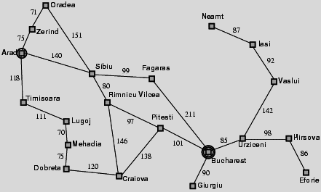
Holiday in Romania Problem

Slide 3
Recall of Agent Types
Simple-reflex agents
directly maps states to actions
cannot operate well in environments where the mapping is too large to store or takes too much to learn
Goal-based agents
can succeed by considering future actions and desirability of their outcomes
Problem solving agent
a goal-based agent
decides what to do by finding sequences of actions that lead to desirable states

Slide 4
Simple Problem Solving Agent
After formulating a goal and a problem to solve, the agent calls a search procedure to solve it
The solution is used to guide agent actions,
doing whatever the solution recommends as the next thing to do (typically the first action in the sequence)
Then removing that step from the sequence
Once the solution has been executed, the agent will formulate a new goal
Notes:
Restricted form of general agent:
Note: this is online problem solving; solution executed \eyes closed."
Online problem solving involves acting without complete knowledge.
What is the goal to be achieved?
Could describe a situation we want to achieve, a set of properties that we want to hold, etc.
Requires defining a “goal test” so that we know what it means to have achieved/satisfied our goal.
This is a hard question that is rarely tackled in AI, usually assuming that the system designer or user will specify the goal to be achieved.
Certainly psychologists and motivational speakers always stress the importance of people establishing clear goals for themselves as the first step towards solving a problem.
Intelligent agents are to maximize their performance measure
This can be simplified if the agent can adopt a goal and aim at satisfying it
Goals help organize behaviour by limiting the objectives that the agent is trying to achieve
Goal formulation, based on the current situation and the agent’s performance measure, is the first step in problem solving
Goal is a set of states. The agent’s task is to find out which sequence of actions will get it to a goal state
Problem formulation is the process of deciding what sorts of actions and states to consider, given a goal
Characterize the primitive actions or events that are available for making changes in the world in order to achieve a goal.
Deterministic world: no uncertainty in an action’s effects. Given an action (a.k.a. operator or move) and a description of the current world state, the action completely specifies
whether that action can be applied to the current world (i.e., is it applicable and legal), and
what the exact state of the world will be after the action is performed in the current world (i.e., no need for "history" information to compute what the new world looks like).
An agent with several immediate options of unknown value can decide what to do
by first considering different possible sequences of actions that lead to states of known value, and
then choosing the best sequence
Looking for such a sequence is called search
A search algorithm takes a problem as input and returns a solution in the form of action sequence
Once a solution is found, its actions can be carried out – execution phase
formulate, search, execute” design steps for the agent

Slide 5
Example Problem I: Holiday in Romania

Slide 6

Example Problem I: Holiday in Romania
Initial state:
$s_{0}$=Arad
Formulate goal:
be in Bucharest (flight leaves tomorrow from Bucharest)
inBucharest($s_{i}$)={True, False}

Slide 7
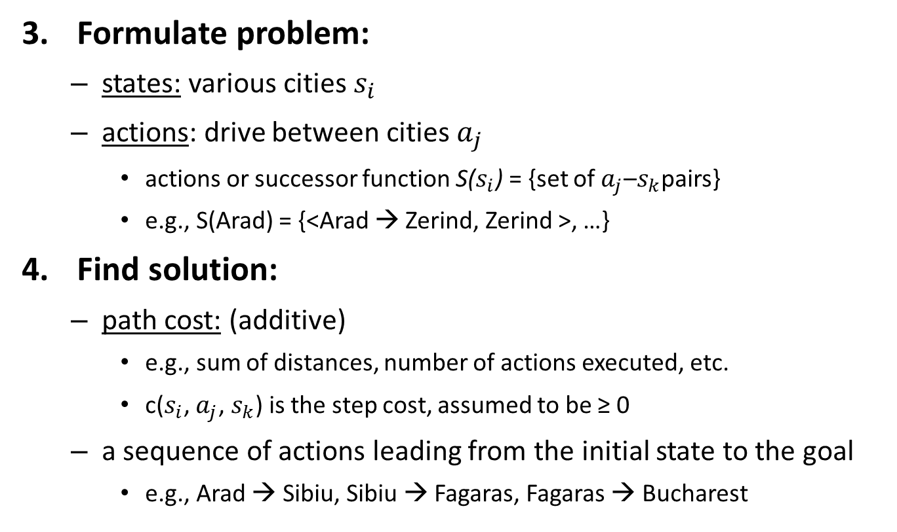
Example Problem I: Holiday in Romania
Formulate problem:
states: various cities $s_{i}$
actions: drive between cities $a_{j}$
actions or successor function S($s_{i}$) = {set of $a_{j}$–$s_{k}$pairs}
e.g., S(Arad) = {<Arad → Zerind, Zerind >, …}
Find solution:
path cost: (additive)
e.g., sum of distances, number of actions executed, etc.
c($s_{i}$, $a_{j}$, $s_{k}$) is the step cost, assumed to be ≥ 0
a sequence of actions leading from the initial state to the goal
e.g., Arad → Sibiu, Sibiu → Fagaras, Fagaras → Bucharest

Slide 8
Search Space
Search space = State space
The set of all states that can be reached in a problem
Fringe or Frontier
The set of states that are farthestly explored but not yet expanded.
EXPLORED
Initial state
Search strategy is a function that selects the next node to be expanded from frontier.
FRINGE
UNEXPLORED
Goal state

Slide 9
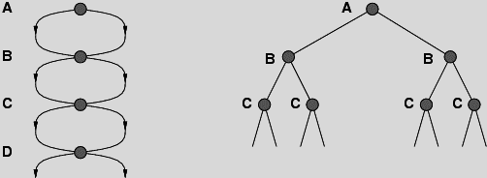
Repeated States
Failure to detect repeated states can turn a linear problem into an exponential one!

Slide 10
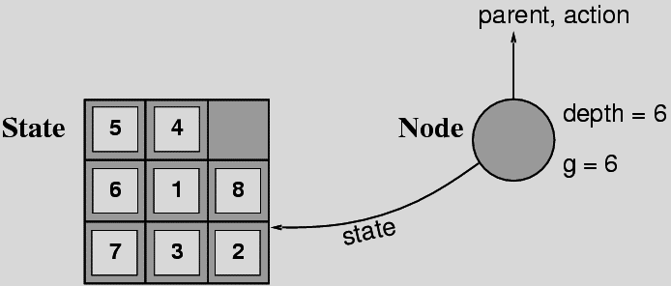
States versus Nodes
A state is a (representation of) a physical configuration
A node is a data structure constituting part of a search tree
includes state, parent node, action, path cost g(x), depth
The Expand function generates new nodes, fills in the various fields using the SuccessorFn of the problem to generate the corresponding states

Slide 11
Selecting a State Space
Real world is absurdly complex
→ state space must be abstracted for problem solving
An abstracted state is a set of real states
For guaranteed realizability, any real state "in Arad“ must get to some real state "in Zerind"
An abstracted action is complex combination of real actions
e.g., "Arad → Zerind" represents a complex set of possible routes, detours, rest stops, etc.
Each abstract action should be "easier" than the original problem
An abstracted solution is a set of real paths that are solutions in the real world

Slide 12
Problem Types
Deterministic, fully observable → single-state problem
Agent knows exactly which state it will be in; solution is a sequence
Non-observable → sensorless (conformant) problem
Agent may have no idea where it is; solution is a sequence
Nondeterministic/partially observable → contingency problem
percepts provide new information about current state
often interleave search, execution
Unknown state space → exploration problem
Notes:
Conformant means in accordance with a set of specificatons.
interleave-> dönüşümlü çalıştır
Contingency→beklenmedik durum
Toy Problems: to show how problem-solving methods work
Real-World Problems: used in various applications such as routing in computer networks, logistics planning, airline travel system, etc.
mak

Slide 13
Real-World Problems
Route finding algorithms are used in a variety of applications, such as
routing in computer networks,
military operations planning,
airline travel planning systems
Route finding problem
States: represented by a location (e.g. an airport) and the current time
Initial state: specified by the problem
Successor function: returns the states resulting from taking any scheduled flight, leaving later than the current time plus the within airport transit time, from the current airport to another
Goal test: are we at the destination by some pre-specified time
Path cost: monetary cost, waiting time, flight time, customs and immigration procedures, seat quality, time of day, type of airplane, frequent-flyer mileage awards, etc.
Touring problems:
visit every city (e.g., in Romania) at least once, starting and ending at Bucharest.
Travelling salesman problem (TSP) :
touring problem, in which each city must be visited exactly once – find the shortest tour.

Slide 14
Real-World Problems
VLSI layout design:
positioning millions of components and connections on a chip to minimize area, minimize circuit delays, minimize stray capacitances, and maximize manufacturing yield
Robot navigation
Internet searching
Automatic assembly sequencing
Protein design:
An assembly problem to find sequence of amino acids.

Slide 15
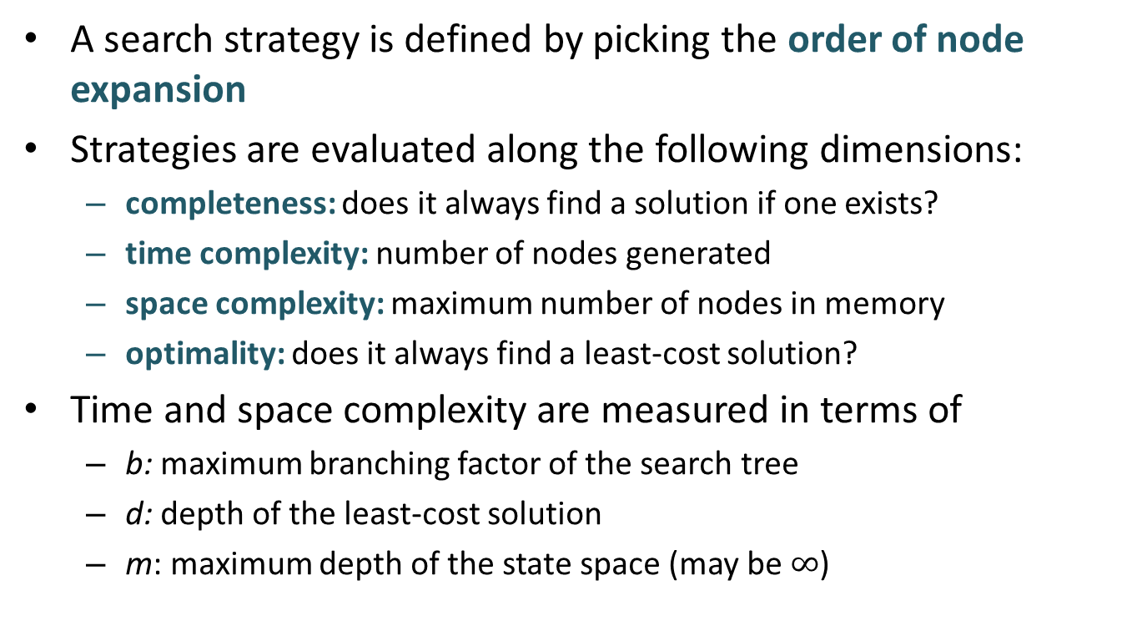
Search Strategies
A search strategy is defined by picking the order of node expansion
Strategies are evaluated along the following dimensions:
completeness: does it always find a solution if one exists?
time complexity: number of nodes generated
space complexity: maximum number of nodes in memory
optimality: does it always find a least-cost solution?
Time and space complexity are measured in terms of
b: maximum branching factor of the search tree
d: depth of the least-cost solution
m: maximum depth of the state space (may be $∞$)

Slide 16
Uninformed Search Strategies
use only the information available in the problem definition
Some uninformed search strategies
Breadth-first search
Depth-first search
Uniform-cost search
Depth-limited search
Iterative deepening search

Slide 17
Breadth-First Search
Expand shallowest unexpanded node
just considering levels of the tree but not the cost
Implementation:
fringe is a FIFO (First In First Out) queue
new successors go at end
stop when goal is visited, not when it is added to fringe

Slide 18
Breadth-First Search
Complete? Yes (if b is finite)
Time? 1+b+b²+b³+… +b^{d} + b(b^{d}-1) = O(b^{d+1})
Space? O(b^{d+1}) (keeps every node in memory)
Optimal? Yes (if cost = 1 per step)
! Space is the bigger problem (more than time)
Notes:
Finite geometric series:
1 + r + r ² + r ³ + .. + r ^{n-1}= ( 1 - r ^{n} ) / (1 - r) for r not equals 1 = nr for r = 1,

Slide 19
Uniform-Cost Search
Equivalent to breadth-first if step costs all equal
Expand least-cost unexpanded node
Implementation:
fringe = queue ordered by path cost
Cannot stop when goal is first generated
What if there is a possibility to find a cheaper path?
Notes:
Cannot stop when goal is first generated

Slide 20
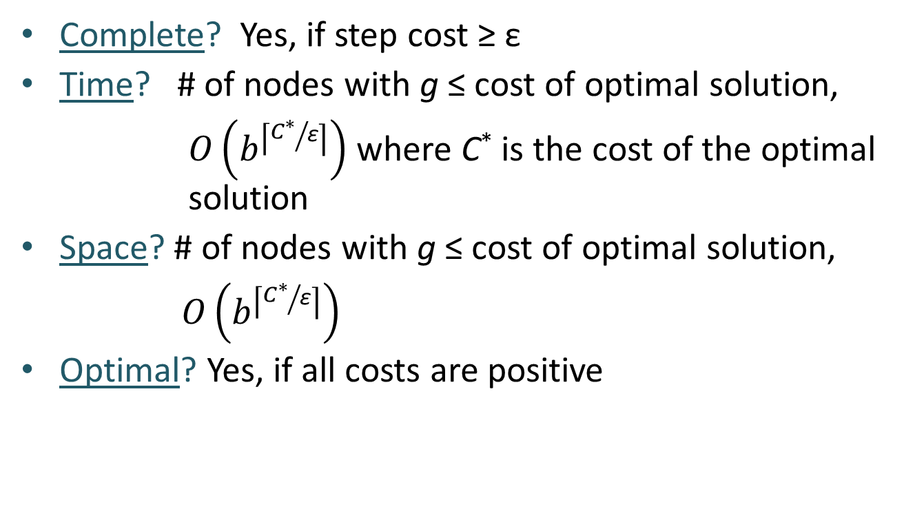
Uniform-Cost Search
Complete? Yes, if step cost ≥ ε
Time? # of nodes with g ≤ cost of optimal solution,
$O\left(b^{\left\lceil {C^{∗}}/{\text{ε}}\right\rceil }\right)$ where C* is the cost of the optimal solution
Space? # of nodes with g ≤ cost of optimal solution,
$O\left(b^{\left\lceil {C^{∗}}/{\text{ε}}\right\rceil }\right)$
Optimal? Yes, if all costs are positive

Slide 21
Depth-First Search
Expand deepest unexpanded node
Implementation:
fringe = LIFO queue (stack), i.e., put successors at front

Slide 22
Depth-First Search
Complete? No: fails in infinite-depth spaces, spaces with loops
Modify to avoid repeated states along path
→ complete in finite spaces
Time? O(b^{m}): terrible if m is much larger than d
but if solutions are dense in state space, may be much faster than BFS
Space? O(bm), i.e., linear space!

Slide 23
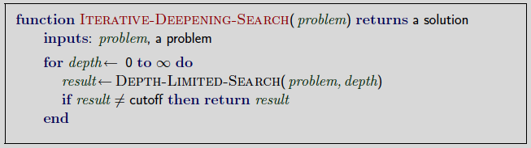
Iterative Deepening Search
Performs depth-limited search for depth = 0 to L
Number of nodes generated in a depth-limited search to depth d with branching factor b:
N_{DLS} = b⁰ + b¹ + b² + … + b^{d-2} + b^{d-1} + b^{d}
Number of nodes generated in an iterative deepening search to depth d with branching factor b:
N_{IDS} = (d+1) b⁰ + d b¹ + (d-1) b² + … + 3b^{d-2} +2b^{d-1} + 1b^{d}

Slide 24
Iterative Deepening Search
For b = 10, d = 5,
N_{DLS} = 1 + 10 + 100 + 1,000 + 10,000 + 100,000 = 111,111
N_{IDS} = 6 + 50 + 400 + 3,000 + 20,000 + 100,000 = 123,456

Slide 25
Iterative Deepening Search
Complete? Yes
Time? (d+1)b⁰ + db¹ + (d-1)b² + … + b^{d} = O(b^{d})
Space? O(bd)
Optimal? Yes, if step cost = 1

Slide 26
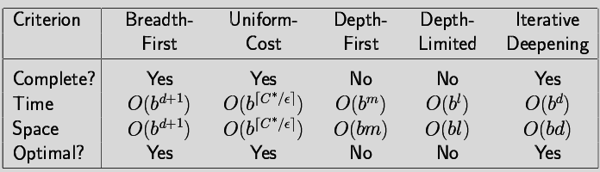
Summary of Uninformed Search Strategies
Problem formulation usually requires abstracting away real-world details to define a state space that can feasibly be explored.
Iterative deepening search uses only linear space and not much more time than other uninformed algorithms.

